Slide 1
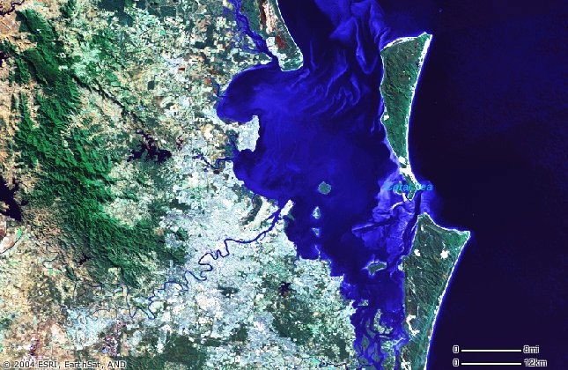
Adventure Works On Location

